Slide 1
COMP 201 OPEN SOURCE & SYSTEM ADMINISTRATION
DANIEL OBUOBI, DCSIT,CU
DOMAIN NAME SERVER

Slide 2
Introduction to the DNS
AFNOG CHIX
October 2008
Accra, Ghana

Slide 3
Overview
Goal of this session
What is DNS ?
How is DNS built and how does it work?
How does a query work ?
Record types
Caching and Authoritative
Delegation: domains vs zones
Finding the error: where is it broken?

Slide 4
Goal of this session
We will review the basics of DNS, including query mechanisms, delegation, and caching.
The aim is to be able to understand enough of DNS to be able to configure a caching DNS server, and troubleshoot common DNS problems, both local and remote (on the Internet)‏

Slide 5
Binary Mathematics
Convert the following binary number to decimal number:
01010010.11001110.
11101111.10101011
Answer:

Slide 6
What is DNS ?
DNS server
DNS stands for Domain Name System.
They are servers (database) that translate fully qualified domain (such as afnog.org) into a proper IP address (196.200.223.1). This is necessary because computers only understand the IP address for your domain.

Slide 7
What is DNS ?
convert names to IP addresses: www.afnog.org → 196.216.2.34 www.afrinic.net → 2001:42d0::200:80:1
... and back: 196.216.2.34 → www.afnog.org 1.0.0.0.0.8.0.0.0.0.2.0.0.0.0.0.0.0.0.0.0.0.0.0.0.d.2.4.1.0.0.2.ip6.arpa. → www.afrinic.net.

Slide 8
What is DNS ?
Other information can be found in DNS:
where to send mail for a domain
who is responsible for this system
geographical information
etc...
How do we look this information up ?

Slide 9
Basic DNS tools
Using the host command: # host www.afnog.org. www.afnog.org has address 196.216.2.34 # host 196.216.2.34 34.2.216.196.in-addr.arpa domain name pointer www.afnog.org.

Slide 10
Basic DNS tools
Host with IPv6: # host www.afrinic.net www.afrinic.net has IPv6 address 2001:42d0::200:80:1 # host 2001:42d0::200:80:1 1.0.0.0.0.8.0.0.0.0.2.0.0.0.0.0.0.0.0.0.0.0.0.0.0.d.2.4.1.0.0.2.ip6.arpa domain name pointer www.afrinic.net.

Slide 11
Basic DNS tools
Try this yourself with other names – first lookup the names below, then do the same for the IP address returned: www.yahoo.com www.nsrc.org ipv6.google.com
Does the lookup of the IP match the name ? Why ?
Where did the 'host' command find the information ?

Slide 12
How is DNS built ?
.(root)‏
/ (root)‏
ma
org
com
etc
bin
usr
/etc/rc.d
usr/local
usr/sbin
ac.ma
afnog.org
nsrc.org
yahoo.com
usr/local/src
emi.ac.ma
www.afnog.org
DNS Database
Unix Filesystem
... forms a tree structure

Slide 13
How is DNS built ?
DNS is hierarchical
DNS administration is shared – no single central entity administrates all DNS data
This distribution of the administration is called delegation

Slide 14
How does DNS work ?
Clients use a mechanism called a resolver and ask servers – this is called a query
The server being queried will try to find the answer on behalf of the client
The server functions recursively, from top (the root) to bottom, until it finds the answer, asking other servers along the way - the server is referred to other servers

Slide 15
How does DNS work ?
The client (web browser, mail program, ...) use the OS’s resolver to find the IP address.
For example, if we go to the webpage www.yahoo.com:
the web browser asks the OS « I need the IP for www.yahoo.com »
the OS looks in the resolver configuration which server to ask, and sends the query
On UNIX, /etc/resolv.conf is where the resolver is configured.

Slide 16
Query detail with tcpdump
Let's lookup 'h1-web.hosting.catpipe.net'
On the server, we do: # tcpdump -n udp and port 53
In another window/screen do: # host <something>

Slide 17
Query detail - output
1: 18:40:38.62 IP 192.168.1.1.57811 > 192.112.36.4.53: 29030 [1au] A? h1-web.hosting.catpipe.net. (55)‏
2: 18:40:39.24 IP 192.112.36.4.53 > 192.168.1.1.57811: 29030- 0/13/16 (540)
3: 18:40:39.24 IP 192.168.1.1.57811 > 192.43.172.30.53: 7286 [1au] A? h1-web.hosting.catpipe.net. (55)‏
4: 18:40:39.93 IP 192.43.172.30.53 > 192.168.1.1.57811: 7286 FormErr- [0q] 0/0/0 (12)
5: 18:40:39.93 IP 192.168.1.1.57811 > 192.43.172.30.53: 50994 A? h1-web.hosting.catpipe.net. (44)‏
6: 18:40:40.60 IP 192.43.172.30.53 > 192.168.1.1.57811: 50994- 0/3/3 (152)
7: 18:40:40.60 IP 192.168.1.1.57811 > 83.221.131.7.53: 58265 [1au] A? h1-web.hosting.catpipe.net. (55)‏
8: 18:40:41.26 IP 83.221.131.7.53 > 192.168.1.1.57811: 58265* 1/2/3 A 83.221.131.6 (139)‏

Slide 18
Query detail - analysis
We use a packet analyzer (wireshark / ethereal) to view the contents of the query...

Slide 19
A DNS query
« . » (root)‏
1
www.yahoo.com ?
ask .com DNS
Q
server
2
client
www.yahoo.com ?
3
87.140.2.33
www.yahoo.com ?
.com DNS
ask Yahoo DNS
A
4
5
www.yahoo.com ?
87.140.2.33
6
yahoo.com DNS

Slide 20
Resolver configuration
So how does your computer know which server to ask to get answers to DNS queries ?
On UNIX, look in /etc/resolv.conf
Look now in the file, and verify that you have a 'nameserver' statement of the form: nameserver a.b.c.d or nameserver ip:v6:ad:dr:es:ss ... where a.b.c.d is the IP/IPv6 of a functioning DNS server (it should).

Slide 21
Finding the root...
The first query is directed to: 192.112.36.4 (G.ROOT-SERVERS.NET.)
How does the server know where to reach the root servers ?
Chicken-and-egg problem
Each namerserver has a list of the root nameservers (A – M.ROOT-SERVERS.NET) and their IP address
In BIND, named.root

Slide 22
Using 'dig' to get more details
the 'host' command is limited in its output – good for lookups, but not enough for debugging.
we use the 'dig' command to obtain more details
dig shows a lot of interesting stuff...

Slide 23
Using 'dig' to get more details
ns# dig @147.28.0.39 www.nsrc.org. a
; <<>> DiG 9.3.2 <<>> @147.28.0.39 www.afnog.org
; (1 server found)‏
;; global options: printcmd
;; Got answer:
;; ->>HEADER<<- opcode: QUERY, status: NOERROR, id: 4620
;; flags: qr aa rd; QUERY: 1, ANSWER: 1, AUTHORITY: 4, ADDITIONAL: 2
;; QUESTION SECTION:
;www.afnog.org. IN A
;; ANSWER SECTION:
www.afnog.org. 14400 IN A 128.223.162.29
;; AUTHORITY SECTION:
afnog.org. 14400 IN NS rip.psg.com.
afnog.org. 14400 IN NS arizona.edu.
;; ADDITIONAL SECTION:
rip.psg.com. 77044 IN A 147.28.0.39
arizona.edu. 2301 IN A 128.196.128.233
;; Query time: 708 msec
;; SERVER: 147.28.0.39#53(147.28.0.39)‏
;; WHEN: Wed May 10 15:05:55 2007
;; MSG SIZE rcvd: 128

Slide 24
noc# dig www.afrinic.net any
; <<>> DiG 9.4.2 <<>> any www.afrinic.net
;; global options: printcmd
;; Got answer:
;; ->>HEADER<<- opcode: QUERY, status: NOERROR, id: 36019
;; flags: qr rd ra; QUERY: 1, ANSWER: 2, AUTHORITY: 6, ADDITIONAL: 10
;; QUESTION SECTION:
;www.afrinic.net. IN ANY
;; ANSWER SECTION:
www.afrinic.net. 477 IN AAAA 2001:42d0::200:80:1
www.afrinic.net. 65423 IN A 196.216.2.1
;; AUTHORITY SECTION:
afrinic.net. 65324 IN NS sec1.apnic.net.
afrinic.net. 65324 IN NS sec3.apnic.net.
afrinic.net. 65324 IN NS ns1.afrinic.net.
afrinic.net. 65324 IN NS tinnie.arin.net.
afrinic.net. 65324 IN NS ns.lacnic.net.
afrinic.net. 65324 IN NS ns-sec.ripe.net.
;; ADDITIONAL SECTION:
ns.lacnic.net. 151715 IN A 200.160.0.7
ns.lacnic.net. 65315 IN AAAA 2001:12ff::7
ns-sec.ripe.net. 136865 IN A 193.0.0.196
ns-sec.ripe.net. 136865 IN AAAA 2001:610:240:0:53::4
ns1.afrinic.net. 65315 IN A 196.216.2.1
tinnie.arin.net. 151715 IN A 168.143.101.18
sec1.apnic.net. 151715 IN A 202.12.29.59
sec1.apnic.net. 151715 IN AAAA 2001:dc0:2001:a:4608::59
sec3.apnic.net. 151715 IN A 202.12.28.140
sec3.apnic.net. 151715 IN AAAA 2001:dc0:1:0:4777::140
;; Query time: 1 msec
;; SERVER: 196.200.218.1#53(196.200.218.1)‏
;; WHEN: Tue May 27 08:48:13 2008
;; MSG SIZE rcvd: 423

Slide 25
dig output
Some interesting fields:
flags section: qr aa rd
status
answer section
authority section
TTL (numbers in the left column)‏
query time
server
Notice the 'A' and 'AAAA' record type in the output.

Slide 26
Record types
Basic record types:
A, AAAA: IPv4, IPv6 address
NS: NameServer
MX: Mail eXchanger
CNAME: Canonical name (alias)‏
PTR: Reverse information

Slide 27
Caching vs Authoritative
In the dig output, and in subsequent outputs, we noticed a decrease in query time if we repeated the query.
Answers are being cached by the querying nameserver, to speed up requests and save network ressources
The TTL value controls the time an answer can be cached
DNS servers can be put in two categories: caching and authoritative.

Slide 28
Caching vs Authoritative: authoritative
Authoritative servers typically only answer queries for data over which they have authority, i.e.: data of which they have an external copy, i.e. from disk (file or database)‏
If they do not know the answer, they will point to a source of authority, but will not process the query recursively.

Slide 29
Caching vs Authoritative: caching
Caching nameservers act as query forwarders on behalf of clients, and cache answers for later.
Can be the same software (often is), but mixing functionality (recursive/caching and authoritative) is discouraged (security risks + confusing)‏
The TTL of the answer is used to determine how long it may be cached without re-querying.

Slide 30
TTL values
TTL values decrement and expire
Try repeatedly asking for the A record for www.yahoo.com: # dig www.yahoo.com
What do you observe about the query time and the TTL ?

Slide 31
SOA
Let's query the SOA for a domain: # dig SOA <domain> ... ;; AUTHORITY SECTION: <domain>. 860 IN SOA ns.<domain>. root.<domain>. 200702270 ; serial 28800 ; refresh 14400 ; retry 3600000 ; expire 86400 ; neg ttl ...

Slide 32
SOA
The first two fields highlighted are:
the SOA (Start Of Authority), which the administrator sets to the name of the « source » server for the domain data (this is not always the case)
the RP (Responsible Person), which is the email address (with the first @ replaced by a '.') to contact in case of technical problems.

Slide 33
SOA
The other fields are:
serial: the serial number of the zone: this is used for replication between two nameservers
refresh: how often a replica server should check the master to see if there is new data
retry: how often to retry if the master server fails to answer after refresh.
expire: when the master server has failed to answer for too long, stop answering clients about this data.
Why is expire necessary ?

Slide 34
Running a caching nameserver
Running a caching nameserver locally can be very useful
Easy to setup, for example on FreeBSD:
add named_enable="YES" to /etc/rc.conf
start named: /etc/rc.d/named start
What is a good test to verify that named is running ?

Slide 35
Running a caching nameserver
When you are confident that your caching nameserver is working, enable it in your local resolver configuration (/etc/resolv.conf): nameserver 127.0.0.1

Slide 36
Delegation
We mentioned that one of the advantages of DNS was that of distribution through shared administration. This is called delegation.
We delegate when there is an administrative boundary and we want to turn over control of a subdomain to:
a department of a larger organization
an organization in a country
an entity representing a country's domain

Slide 37
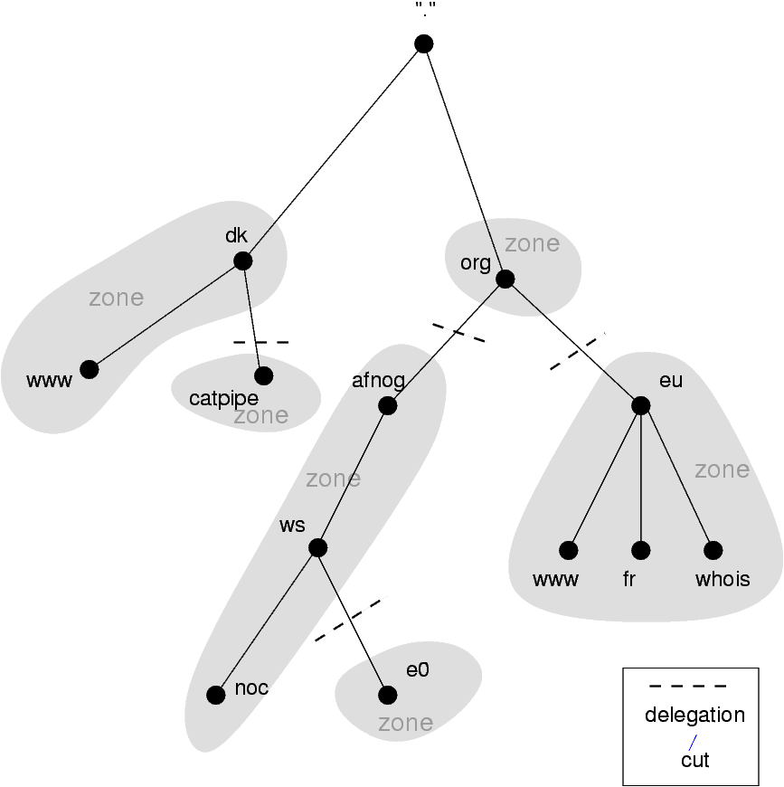
Delegation

Slide 38
Delegation: Domains vs Zones
When we talk about the entire subtree, we talk about domains
When we talk about part of a domain that is administered by an entity, we talk about zones

Slide 39
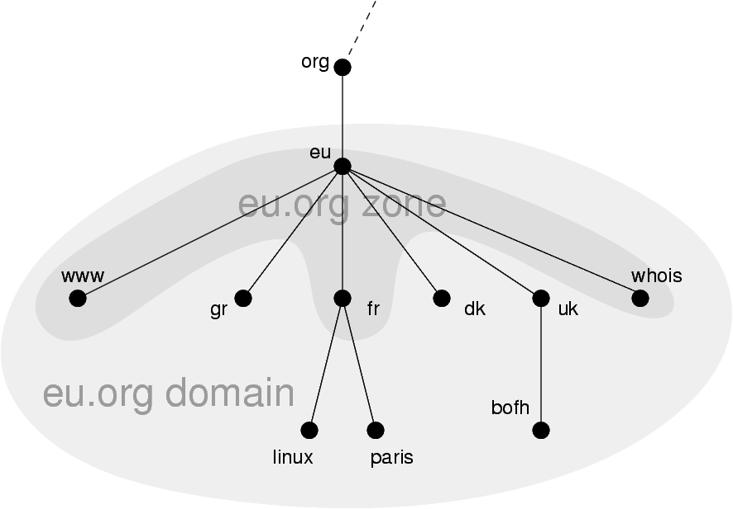
Delegation: Domains vs Zones

Slide 40
Finding the error: using doc
When you encounter problems with your network, web service or email, you don't always suspect DNS.
When you do, it's not always obvious what the problem is – DNS is tricky.
A great tool for quickly spotting configuration problems is 'doc'
/usr/ports/dns/doc – install it now!
Let's do a few tests on screen with doc...

Slide 41
Conclusion
DNS is a vast subject
It takes a lot of practice to pinpoint problems accurately the first time – caching and recursion are especially confusing
Remember that there are several servers for the same data, and you don't always talk to the same one
Practice, practice, practice!
Don't be afraid to ask questions...

Slide 42
Configuration of Authoritative Name Service
AfCHIX 2008
Accra, Ghana
(based on slides from Brian Candler for NSRC)‏

Slide 43
Recap
DNS is a distributed database
Resolver asks Cache for information
Cache traverses the DNS delegation tree to find Authoritative nameserver which has the information requested
Bad configuration of authoritative servers can result in broken domains

Slide 44
DNS Replication
For every domain, we need more than one authoritative nameserver with the same information (RFC 2182)‏
Data is entered in one server (Master) and replicated to the others (Slave(s))‏
Outside world cannot tell the difference between master and slave
NS records are returned in random order for equal load sharing
Used to be called "primary" and "secondary"

Slide 45
Slaves connect to Master to retrieve copy of zone data
The master does not "push" data to the slaves
Slave
Master
Slave

Slide 46
When does replication take place?
Slaves poll the master periodically - called the "Refresh Interval" - to check for new data
Originally this was the only mechanism
Master can also notify the slaves when the data changes
Results in quicker updates
The notification is unreliable (e.g. network might lose a packet) so we still need checks at the Refresh Interval

Slide 47
Serial Numbers
Every zone file has a Serial Number
Slave will only copy data when this number INCREASES
Periodic UDP query to check Serial Number
If increased, TCP transfer of zone data
It is your responsibility to increase the serial number after every change, otherwise slaves and master will be inconsistent

Slide 48
Recommended serial number format: YYYYMMDDNN
YYYY = year
MM = month (01-12)‏
DD = day (01-31)‏
NN = number of changes today (00-99)‏
e.g. if you change the file on 5th March 2004, the serial number will be 2004030500. If you change it again on the same day, it will be 2004030501.

Slide 49
Serial Numbers: Danger 1
If you ever decrease the serial number, the slaves will never update again until the serial number goes above its previous value
RFC1912 section 3.1 explains a method to fix this problem
At worst, you can contact all your slaves and get them to delete their copy of the zone data

Slide 50
Serial Numbers: Danger 2
Serial no. is a 32-bit unsigned number
Range: 0 to 4,294,967,295
Any value larger than this is silently truncated
e.g. 20040305000 (note extra digit)‏
= 4AA7EC968 (hex)‏
= AA7EC968 (32 bits)‏
= 2860435816
If you make this mistake, then later correct it, the serial number will have decreased

Slide 51
Configuration of Master
/etc/namedb/named.conf points to zone file (manually created) containing your RRs
Choose a logical place to keep them
e.g. /etc/namedb/master/tiscali.co.uk
or /etc/namedb/master/uk.co.tiscali
zone "example.com" {
type master;
file "master/example.com";
allow-transfer { 192.188.58.126;
192.188.58.2; };
};

Slide 52
Configuration of Slave
named.conf points to IP address of master and location where zone file should be created
Slave zone files are transferred automatically
Don't edit them!
zone "example.com" {
type slave;
masters { 192.188.58.126; };
file "slave/example.com";
allow-transfer { none; };
};

Slide 53
Master and Slave
It's perfectly OK for one server to be Master for some zones and Slave for others
That's why we recommend keeping the files in different directories
/etc/namedb/master/
/etc/namedb/slave/
(also, the slave directory must have appropriate permissions so that the daemon can create files)‏

Slide 54
allow-transfer { ... }
Remote machines can request a transfer of the entire zone contents
You can control who is allowed to grab a copy of the zone.
By default, only nameservers of the zone can (as declared in the zone)‏
You can set a global default, and override this for each zone if required
options {
allow-transfer { 127.0.0.1; };
};

Slide 55
Structure of a zone file
Global options
$TTL 1d
Sets the default TTL for all other records
SOA RR
"Start Of Authority"
Housekeeping information for the zone
NS RRs
List all the nameservers for the zone, master and slaves
Other RRs
The actual data you wish to publish

Slide 56
Format of a Resource Record
www 3600 IN A 212.74.112.80
Domain TTL Class Type Data
One per line (except SOA can extend over several lines)‏
If you omit the Domain Name, it is the same as the previous line
TTL shortcuts: e.g. 60s, 30m, 4h, 1w2d
If you omit the TTL, uses the $TTL default value
If you omit the Class, it defaults to IN
Type and Data cannot be omitted
Comments start with SEMICOLON (;)‏

Slide 57
Shortcuts
If the Domain Name does not end in a dot, the zone's own domain ("origin") is appended
A Domain Name of "@" means the origin itself
e.g. in zone file for example.com:
@ means example.com.
www means www.example.com.

Slide 58
If you write this...
$TTL 1d
@ SOA ( ... )‏
NS ns0
NS ns0.as9105.net.
; Main webserver
www A 212.74.112.80
MX 10 mail
... it becomes this
example.com. 86400 IN SOA ( ... )‏
example.com. 86400 IN NS ns0.example.com.
example.com. 86400 IN NS ns0.as9105.net.
www.example.com. 86400 IN A 212.74.112.80
www.example.com. 86400 IN MX 10 mail.example.com.

Slide 59
Format of the SOA record
$TTL 1d
@ 1h IN SOA ns1.example.net. hervey.nsrc.org. (
2004030300 ; Serial
8h ; Refresh
1h ; Retry
4w ; Expire
1h ) ; Negative
IN NS ns1.example.net.
IN NS ns2.example.net.
IN NS ns1.othernetwork.com.

Slide 60
Format of the SOA record
ns1.example.net.
hostname of master nameserver
hervey@nsrc.org.
E-mail address of responsible person, with trailing dot
In older versions of "@" changed to dot
Serial number
Refresh interval
How often Slave checks serial number on Master
Retry interval
How often Slave checks serial number if the Master did not respond

Slide 61
Format of the SOA record (cont)‏
Expiry time
If the slave is unable to contact the master for this period of time, it will delete its copy of the zone data
Negative / Minimum
Old software used this as a minimum value of the TTL
Now it is used for negative caching: indicates how long a cache may store the non-existence of a RR
RIPE-203 has recommended values
http://www.ripe.net/ripe/docs/dns-soa.html

Slide 62
Format of NS records
List all authoritative nameservers for the zone - master and slave(s)‏
Must point to HOSTNAME not IP address
$TTL 1d
@ 1h IN SOA ns1.example.net. brian.nsrc.org. (
2004030300 ; Serial
8h ; Refresh
1h ; Retry
4w ; Expire
1h ) ; Negative
IN NS ns1.example.net.
IN NS ns2.example.net.
IN NS ns1.othernetwork.com.

Slide 63
Format of other RRs
IN A 1.2.3.4
IN MX 10 mailhost.example.com.
The number is a "preference value". Mail is delivered to the lowest-number MX first
Must point to HOSTNAME not IP address
IN CNAME host.example.com.
IN PTR host.example.com.
IN TXT "any text you like"

Slide 64
When you have added or changed a zone file:
Remember to increase the serial number!
named-checkzone example.com \ /etc/namedb/master/example.com
bind 9 feature
reports zone file syntax errors; correct them!
named-checkconf
reports errors in named.conf
rndc reload
or: rndc reload example.com
tail /var/log/messages

Slide 65
These checks are ESSENTIAL
If you have an error in named.conf or a zone file, named may continue to run but will not be authoritative for the bad zone(s)‏
You will be lame for the zone without realising it
Slaves will not be able to contact the master
Eventually (e.g. 4 weeks later) the slaves will expire the zone
Your domain will stop working

Slide 66
Other checks you can do
dig +norec @x.x.x.x example.com. soa
Check the AA flag
Repeat for the master and all the slaves
Check the serial numbers match
dig @x.x.x.x example.com. axfr
"Authority Transfer"
Requests a full copy of the zone contents over TCP, as slaves do to master
This will only work from IP addresses listed in the allow-transfer {...} section

Slide 67
So now you have working authoritative nameservers!
But none of this will work until you have delegation from the domain above
That is, they put in NS records for your domain, pointing at your nameservers
You have also put NS records within the zone file
The two sets should match

Slide 68
Any questions?
?

Slide 69
TOP TEN ERRORS in authoritative nameservers
All operators of auth nameservers should read RFC 1912
Common DNS Operational and Configuration Errors
And also RFC 2182
Selection and Operation of Secondary DNS servers

Slide 70
1. Serial number errors
Forgot to increment serial number
Incremented serial number, then decremented it
Used serial number greater than 2³²
Impact:
Slaves do not update
Master and slaves have inconsistent data
Caches will sometimes get the new data and sometimes old - intermittent problem

Slide 71
2. Comments in zone files starting '#' instead of ';'
Syntax error in zone file
Master is no longer authoritative for the zone
Slaves cannot check SOA
Slaves eventually expire the zone, and your domain stops working entirely
Use "named-checkzone"
Use "tail /var/log/messages"

Slide 72
3. Other syntax errors in zone files
e.g. omitting the preference value from MX records
Same impact

Slide 73
4. Missing the trailing dot
; zone example.com.
@ IN MX 10 mailhost.example.com
becomes
@ IN MX 10 mailhost.example.com.example.com.
; zone 2.0.192.in-addr.arpa.
1 IN PTR host.example.com
becomes
1 IN PTR host.example.com.2.0.192.in-addr.arpa.

Slide 74
5. NS or MX records pointing to IP addresses
They must point to hostnames, not IP addresses
Unfortunately, a few mail servers do accept IP addresses in MX records, so you may not see a problem with all remote sites

Slide 75
6. Slave cannot transfer zone from master
Access restricted by allow-transfer {...} and slave not listed
Or IP filters not configured correctly
Slave will be lame (non-authoritative)‏

Slide 76
7. Lame delegation
You cannot just list any nameserver in NS records for your domain
You must get agreement from the nameserver operator, and they must configure it as a slave for your zone
At best: slower DNS resolution and lack of resilience
At worst: intermittent failures to resolve your domain

Slide 77
8. No delegation at all
You can configure "example.com" on your nameservers but the outside world will not send requests to them until you have delegation
The problem is hidden if your nameserver is acting both as your cache and as authoritative nameserver
Your own clients can resolve www.example.com, but the rest of the world cannot

Slide 78
9. Out-of-date glue records
See later

Slide 79
10. Not managing TTL correctly during changes
e.g. if you have a 24 hour TTL, and you swing www.example.com to point to a new server, then there will be an extended period when some users hit one machine and some hit the other
Follow the procedure:
Reduce TTL to 10 minutes
Wait at least 24 hours
Make the change
Put the TTL back to 24 hours

Slide 80
Practical
Create a new domain
Set up master and slave nameservice
Obtain delegation from the domain above
Test it

Slide 81
Part II – advanced delegation
AfCHIX 2008
Accra, Ghana
(based on slides from Brian Candler for NSRC)‏

Slide 82
Summary: How do you delegate a subdomain?
In principle straightforward: just insert NS records for the subdomain, pointing at someone else's servers
If you are being careful, you should first check that those servers are authoritative for the subdomain
by using "dig +norec" on all the servers
If the subdomain is managed badly, it reflects badly on you!
and you don't want to be fielding problem reports when the problem is somewhere else

Slide 83
Zone file for "example.com"
$TTL 1d
@ 1h IN SOA ns1.example.net. hervey@nsrc.org. (
2007112601 ; Serial
8h ; Refresh
1h ; Retry
4w ; Expire
1h ) ; Negative
IN NS ns1.example.net.
IN NS ns2.example.net.
IN NS ns1.othernetwork.com.
; My own zone data
IN MX 10 mailhost.example.net.
www IN A 212.74.112.80
; A delegated subdomain
subdom IN NS ns1.othernet.net.
IN NS ns2.othernet.net.

Slide 84
There is one problem here:
NS records point to names, not IPs
What if zone "example.com" is delegated to "ns.example.com"?
Someone who is in the process of resolving (say) www.example.com first has to resolve ns.example.com
But in order to resolve ns.example.com they must first resolve ns.example.com !

Slide 85
In this case you need "glue"
A "glue record" is an A record for the nameserver, held higher in the tree
Example: consider the .com nameservers, and a delegation for example.com
; this is the com. zone
example NS ns.example.com.
NS ns.othernet.net.
ns.example.com. A 192.0.2.1 ; GLUE RECORD

Slide 86
Don't put in glue records except where necessary
In the previous example, "ns.othernet.net" is not a subdomain of "example.com".
Therefore no glue is needed.
Out-of-date glue records are a big source of problems
e.g. after renumbering a nameserver
Results in intermittent problems, difficult to debug

Slide 87
Example where a glue record IS needed
; My own zone data
IN MX 10 mailhost.example.net.
www IN A 212.74.112.80
; A delegated subdomain
subdom IN NS ns1.subdom ; needs glue
IN NS ns2.othernet.net. ; doesn't
ns1.subdom IN A 192.0.2.4

Slide 88
Checking for glue records
dig +norec ... and repeat several times
Look for A records in the "Additional" section whose TTL does not count down
$ dig +norec @a.gtld-servers.net. www.as9105.net. a
...
;; flags: qr; QUERY: 1, ANSWER: 0, AUTHORITY: 2, ADDITIONAL: 1
;; QUERY SECTION:
;; www.as9105.net, type = A, class = IN
;; AUTHORITY SECTION:
as9105.net. 172800 IN NS ns0.as9105.com.
as9105.net. 172800 IN NS ns0.tiscali.co.uk.
;; ADDITIONAL SECTION:
ns0.as9105.com. 172800 IN A 212.139.129.130

Slide 89
Practical
Delegating a subdomain

Slide 90
DNS: Summary
Distributed database of Resource Records
e.g. A, MX, PTR, ...
Three roles: resolver, cache, authoritative
Resolver statically configured with nearest caches
e.g. /etc/resolv.conf
Caches are seeded with a list of root servers
zone type "hint", /etc/namedb/named.root
Authoritative servers contain RRs for certain zones (part of the DNS tree)‏
replicated for resilience and load-sharing

Slide 91
DNS: Summary (cont)‏
Root nameservers contain delegations (NS records) to gTLD or country-level servers (com, uk etc)‏
These contain further delegations to subdomains
Cache finally locates an authoritative server containing the RRs requested
Errors in delegation or in configuration of authoritative servers result in no answer or inconsistent answers

Slide 92
Further reading
"DNS and BIND" (O'Reilly)‏
BIND 9 Administrator Reference Manual
/usr/share/doc/bind9/arm/Bv9ARM.html
http://www.isc.org/sw/bind/
includes FAQ, security alerts
RFC 1912, RFC 2182
http://www.rfc-editor.org/

